Slide 1
India vs China trade and competition
Group-5

Slide 2
Group Members
Nand Parikh 1401023
Prerak Raja 1401041
Varad Bhogayata 1401042
Jay Joshi 1401052
Parth Shah 1401054
Bhavya Patwa 1401063
Ridhesh Sanghavi 1401074
Karan Patel 1401113

Slide 3
Contents
Indian Economy
Chinese Economy
India Vs China global level
Indian trade
Chinese trade
India-China bilateral trade

Slide 4
Indian economy
Indian economy is the 7th largest in the world by nominal GDP.
Our economy is 3rd largest by purchasing power parity (PPP).
On per capita income basis India ranked 141st by nominal GDP and 130th by PPP.
Our diversified economy encompasses traditional village farming, modern agriculture, a wide range of modern industries and multitude of services.
More than half population of India is dependent on agriculture, but services are major source of economic growth providing 2/3rd of total output with only 1/3rd of labour force.

Slide 5
GDP sector-wise

Slide 6
Labour force sector-wise

Slide 7
Indian economy (Prior to 1990)
The independence era (1947-1991) was based on a mixed economy combining the features of both capital and social economy.
Sectors which had direct impact on citizens like supplying electricity, banking sector, etc. were owned by government.
As India faced a long British rule, economy was not liberal for global trades, also import – export duties were very high, norms and regulations to establish industries were not flexible.
Corruption, inefficiency to take advantage of post-war expansion of trade, added to above factors for poor growth and development of country.

Slide 8
Indian economy (Abolishing ‘Licence Raj’)
In 1991, India adopted liberal and free-market principles, under the guidance of former finance minister Dr. Manmohan Singh and former prime minister P.V. Narsinhma Rao .
With the advent of liberalization many industries flourished and new sectors developed e.g. private commercial banking sector (HDFC, ICICI, etc.), IT industries (TCS, reliance technologies, Satyam, etc.)
Privatization, deregulations of governmental bodies took place.
As import-export policies became flexible FDI increased.
World saw a whole new potential in Indian market, major economic reforms took place, growth accelerated and is averaged more than 7% since 1997.

Slide 9
Indian economy (Rise of Modern India)
Great example of economic stability was seen, when India rebounded robustly after major financial crisis with, growth rate of more than 8%.
Strong domestic demands, ample of youth and demand of Indian goods, resulting in more employment in fragile financial situations were some of the key features of growth.
But with high rise in inflation, decline in FDIs due to global crisis, increase in crude price, added to fiscal deficit which hindered India’s growth for next 2 years and India saw a new low of 4.5%.
In late 2012 former chief of IMF Dr. Raghuram Rajan was appointed as new governor of RBI, under whose guidance government announced deficit reduction reforms to reverse India’s slow down.
Results proved promising and India’s growth rate was 6.6% in fiscal year 2013-14.

Slide 10
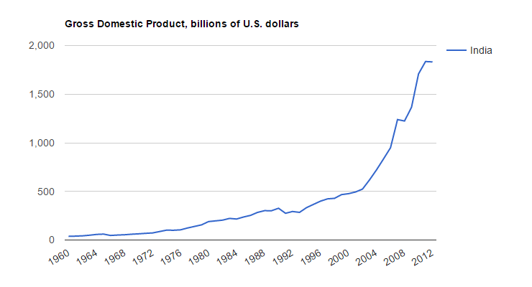
India’s GDP (Promising Heights)

Slide 11
Indian economy (Major problems)
High inflation rates
High corruption rates
Poor infrastructure
Balance of Payment (BOP) deterioration
Inequality has risen instead of decreasing
Large Budget deficit
Rigid labour laws
Inefficient agriculture.

Slide 12
Indian economy (Steps taken)
Our new monetary policies made under the guidance of Dr. Raghuram Rajan has impacted greatly on our fiscal policies.
Greater funds are pushed in sectors requiring good finance for growth and development.
Economy’s heart, agricultural sector has got special attention.
Privatization of agricultural sector, have unified many fertile lands on which no agricultural work was done.
Money has been made highly liquid for education, infrastructure and employment schemes.
‘MANREGA’, better municipal schools, free education to poor but deserving student, compulsion courses on food and agriculture at IIT’s and other premium institutes, pushing technological aspects in every sectors.
‘MAKE IN INDIA, MADE IN INDIA’ has made huge impact. Intex, Micromax, Flipkart, Snapdeal, OYO rooms, PRACTO etc. are some of the Indian ventures and start-ups that have caught global attention.
Many companies had shown interest in investing in India due to liberal Indian policies, hence FDI has increased.
Foreign successes like Google, Microsoft, L&T, Samsung, etc. have started their production or development unit in India.

Slide 13
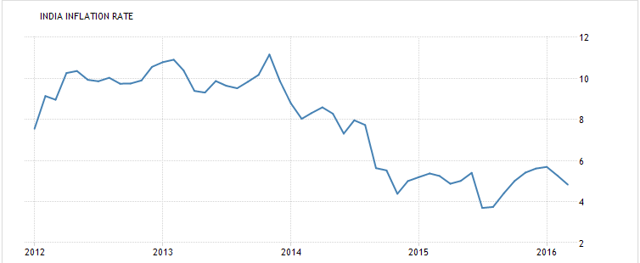
India’s inflation rate.

Slide 14
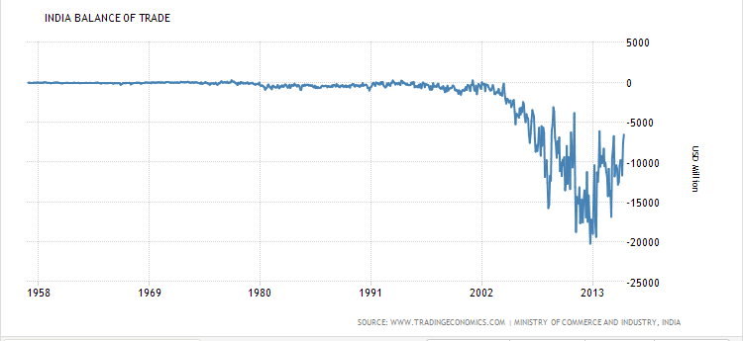
India’s BOP

Slide 15
Indian economy (Satisfying outcomes)
Outcomes of these efforts by government are pretty good.
Inflation rate has reduced below 6% which was once 10% in year 2010-2011.
BOP has also increased, as of 2016 our BOP is nearly -3500 mill US dollar, due to potential growth many economist estimates a positive BOP for India in near future.
India ranks pretty high in exports, India was far behind in 50s prior to economic reforms, but now India ranks 19th in export.
India is a large exporter of skilled IT professionals to many western countries, such educated youth proves potential of future India.
With the advent of information technology in every sector, transparency has increased due to which corruption has lowered to great extent.
Heavy taxes on luxurious goods and low taxes on daily requirements helps to solve issues of inequality.

Slide 16
Indian economy (Final Word)
Indian GDP crossed 2 trillion in 2015 and as of now India has GDP of whooping 2.4 trillion.
But along with growth sustainable development is also required, government had introduced various schemes for ensuring development along with growth.
Factors like large scale unemployment, nearly 1/3rd of population under poverty line, high inflations had always hindered India’s development.
Indian happiness index was below Pakistan, Philippine and many more developing nation according to recent surveys.
Indian economy has to overcome its faults for placing India at a higher level in global market.

Slide 17
Chinese economy
For the first time in more than 140 years, the US has lost the title of the world's largest economy - it has been stolen by China, according to the IMF
The Chinese economy is now worth $17.6tn, slightly higher than the $17.4tn the International Monetary Fund (IMF) estimates for the US.
China's economy has grown increasingly faster since the 1978 introduction of economic reforms. The Chinese official statistics show that real gross domestic product (GDP) from 1979 to 1999 was growing at an average annual rate of 9.7 %, making China one the world's fastest growing economies.
According to the World Bank, China's rapid development has raised nearly 200 million people out of extreme poverty.

Slide 18
Chinese economy
Since its establishment in 1949 and until the end of 1978, China maintained a centrally planned, or command, economy.
By 1978, nearly three-fourths of the country's industrial production was produced by centrally controlled state-owned enterprises (SOEs) according to centrally planned output targets.
It was estimated that China's real GDP grew at an average annual rate of about 5.3 percent from 1960 to 1978

Slide 19
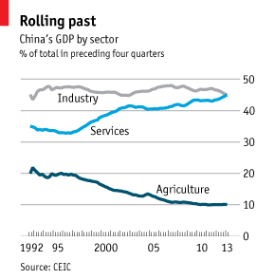
GDP by sectors

Slide 20
Chinese economy (Reforms)
The first of China's economic reforms started in 1978 when Den Xiaoping came into power again. The reforms concentrated on the agricultural production system in rural areas.
In addition, the reforms tried to cover
Foreign Investment
Boost Exports
Beginning of the importation of high technology products into the country

Slide 21
Chinese economy (Change in GDP)
The transition of the country's economic system from a command to a market-based economy helped fuel a strong average growth. Between the start of an economic reform program in 1978 and 1995, the GDP growth was 8.0 % a year. Remained strong for 1996-2000 also.
In 1999 China became the second largest economy in the world, after the United States.
Story does not ends here, in 2003 China became leading first Asian economy to cross 5 trillion mark, in 2010 China with an economy of 10.33 trillion became the first Asian economy to cross 10 trillion.
It’s race continued to an absolutely opposite competitor USA, which had a free economy and surpassed US in 2015.

Slide 22
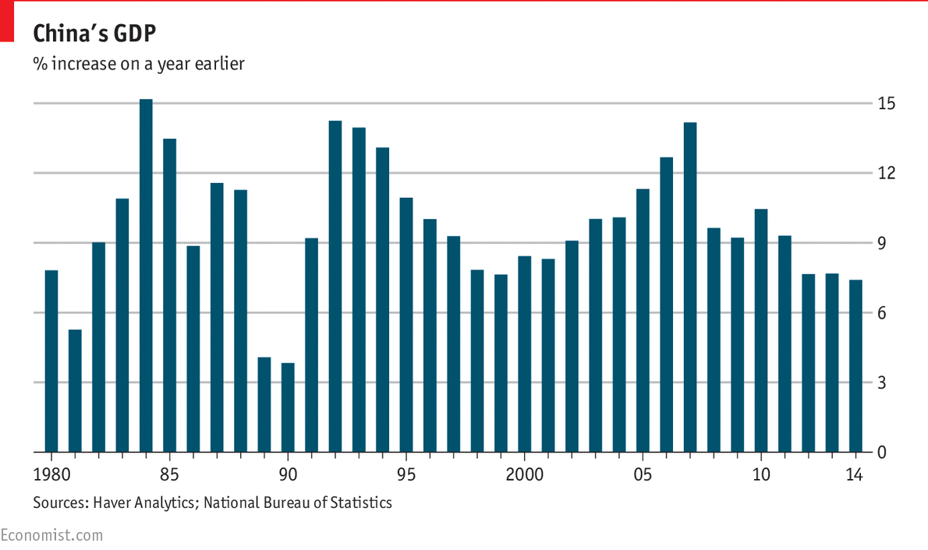
Overall GDP Graph

Slide 23
Chinese economy (Factors affecting the economy)
China’s economic miracle is genuine:
Growth ≈ 10% p.a. for 3 decades is historic.
It took the UK 58 years to double income, starting from 1780
But it took China only around 8 years, from 1987 !
On the other hand, China is still poor:
It ranks only midway among 190 countries (85th , just above Peru).
China’s growth has slowed down relative to its past double-digit rates in the recent years.
Unlike India’s economic problems Chinese economy faces many major crisis as follows
Technical catch-up,
Capital/labor ratio,
Rural urban migration,
Rising costs of labor & land.
Services have a lower rate of productivity growth

Slide 24
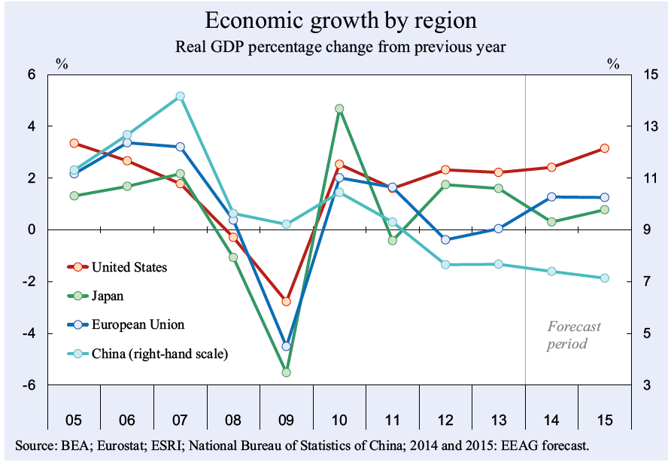
Chinese economy (Trade since the 2008 crisis)

Slide 25
Chinese economy (Steps taken)
Chinese economy which is mainly dependent on manufacturing, is now entering the service sector.
The main reason behind this is though China provides quantity of goods, it always lacks in terms of quality.
With the urge of developing better quality goods, quality regulation has been increased.
China world’s 2nd largest importer of goods, now has again started paying heed to their agricultural sector.
Development of service sectors rather than industrial sector is focused.
Another major issue banking, is now solved at some extent with more market driven financial policies.
Chinese market is now welcoming market economy to some extent.
Service and employment generating sectors such as IT, media, are now emphasized rather than revenue generating industrial sector.

Slide 26
Chinese economy (Final Word)
China is still leading the world in exports and in GDP.
Due to various steps taken by Chinese government, companies like ONE Plus, Ali baba, etc. has been developed
China’s service sector as taken a great jump and is now covering 44% of its economy.
China has truly proved that it is a ‘rebalancing’ economy.
Still China has not found its place in economic development.
Chinese economy has great rate of unemployment which needs to be solved.
Happiness index of China was ranked below India.
Like India China also has to work really hard for gaining a good HDI for its citizen.

Slide 27
India Vs China (Global level)
India and China both are global competitors, both economy tries to surpass other at various levels.
There are certain factors on basis of which an estimate can be drawn about the future and current status of both the economies.
Business freedom
Fiscal freedom
Freedom from corruption
Government spending
Labour freedom
Trade freedom
Monetary Spending
Property Rights
Each of the are graphically shown and will be explained in short.

Slide 28
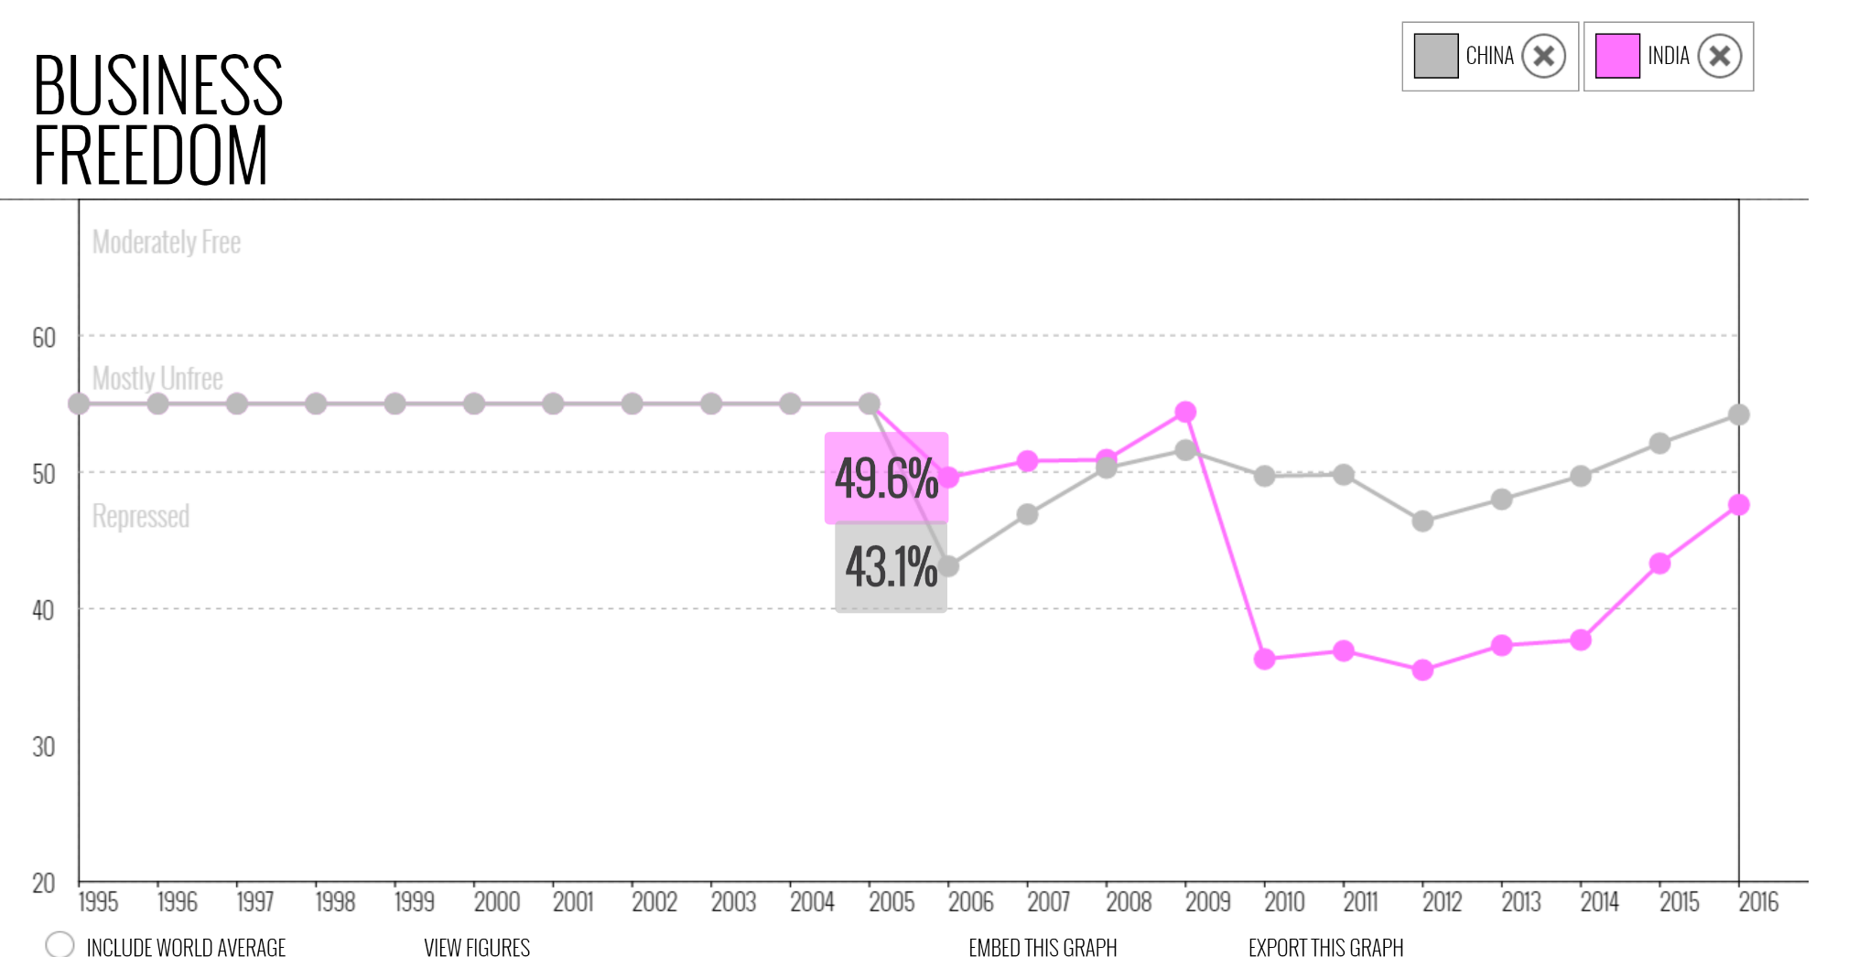
Business freedom

Slide 29
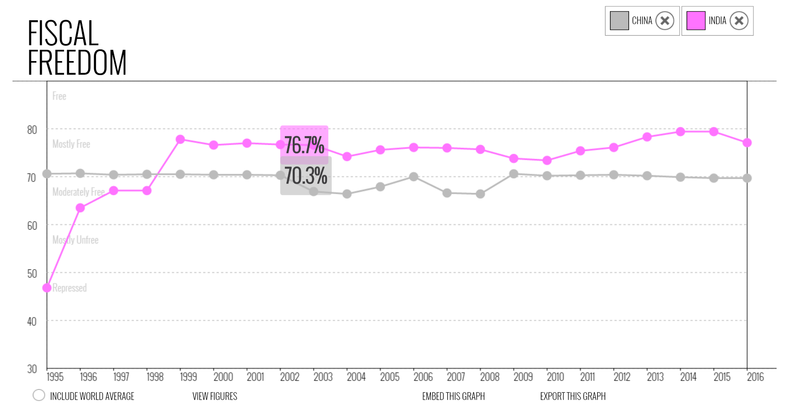
Fiscal freedom

Slide 30
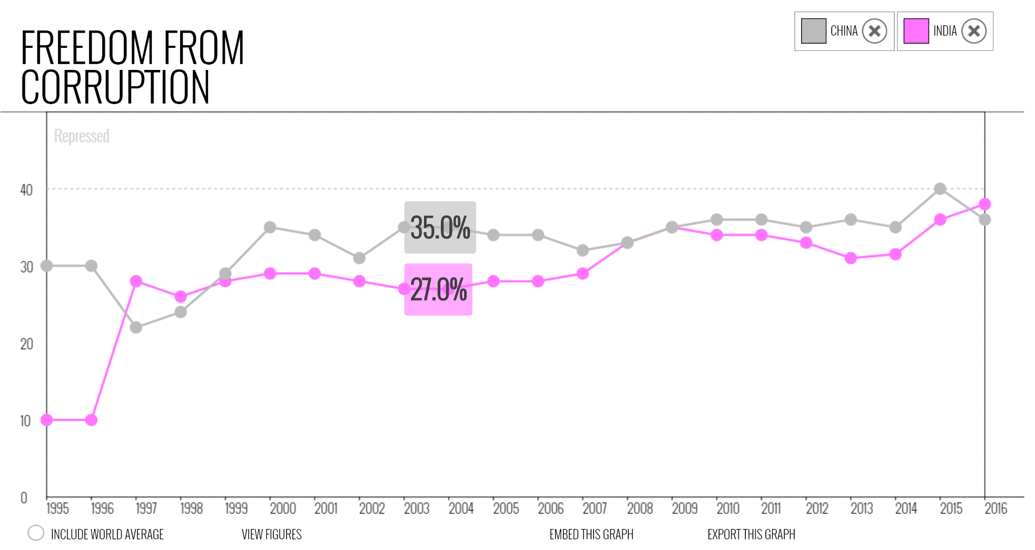
Freedom from corruption

Slide 31
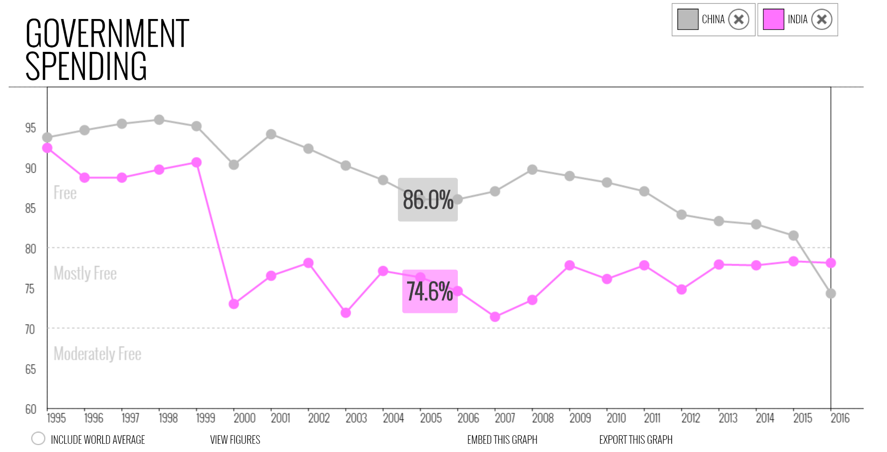
Government spending

Slide 32
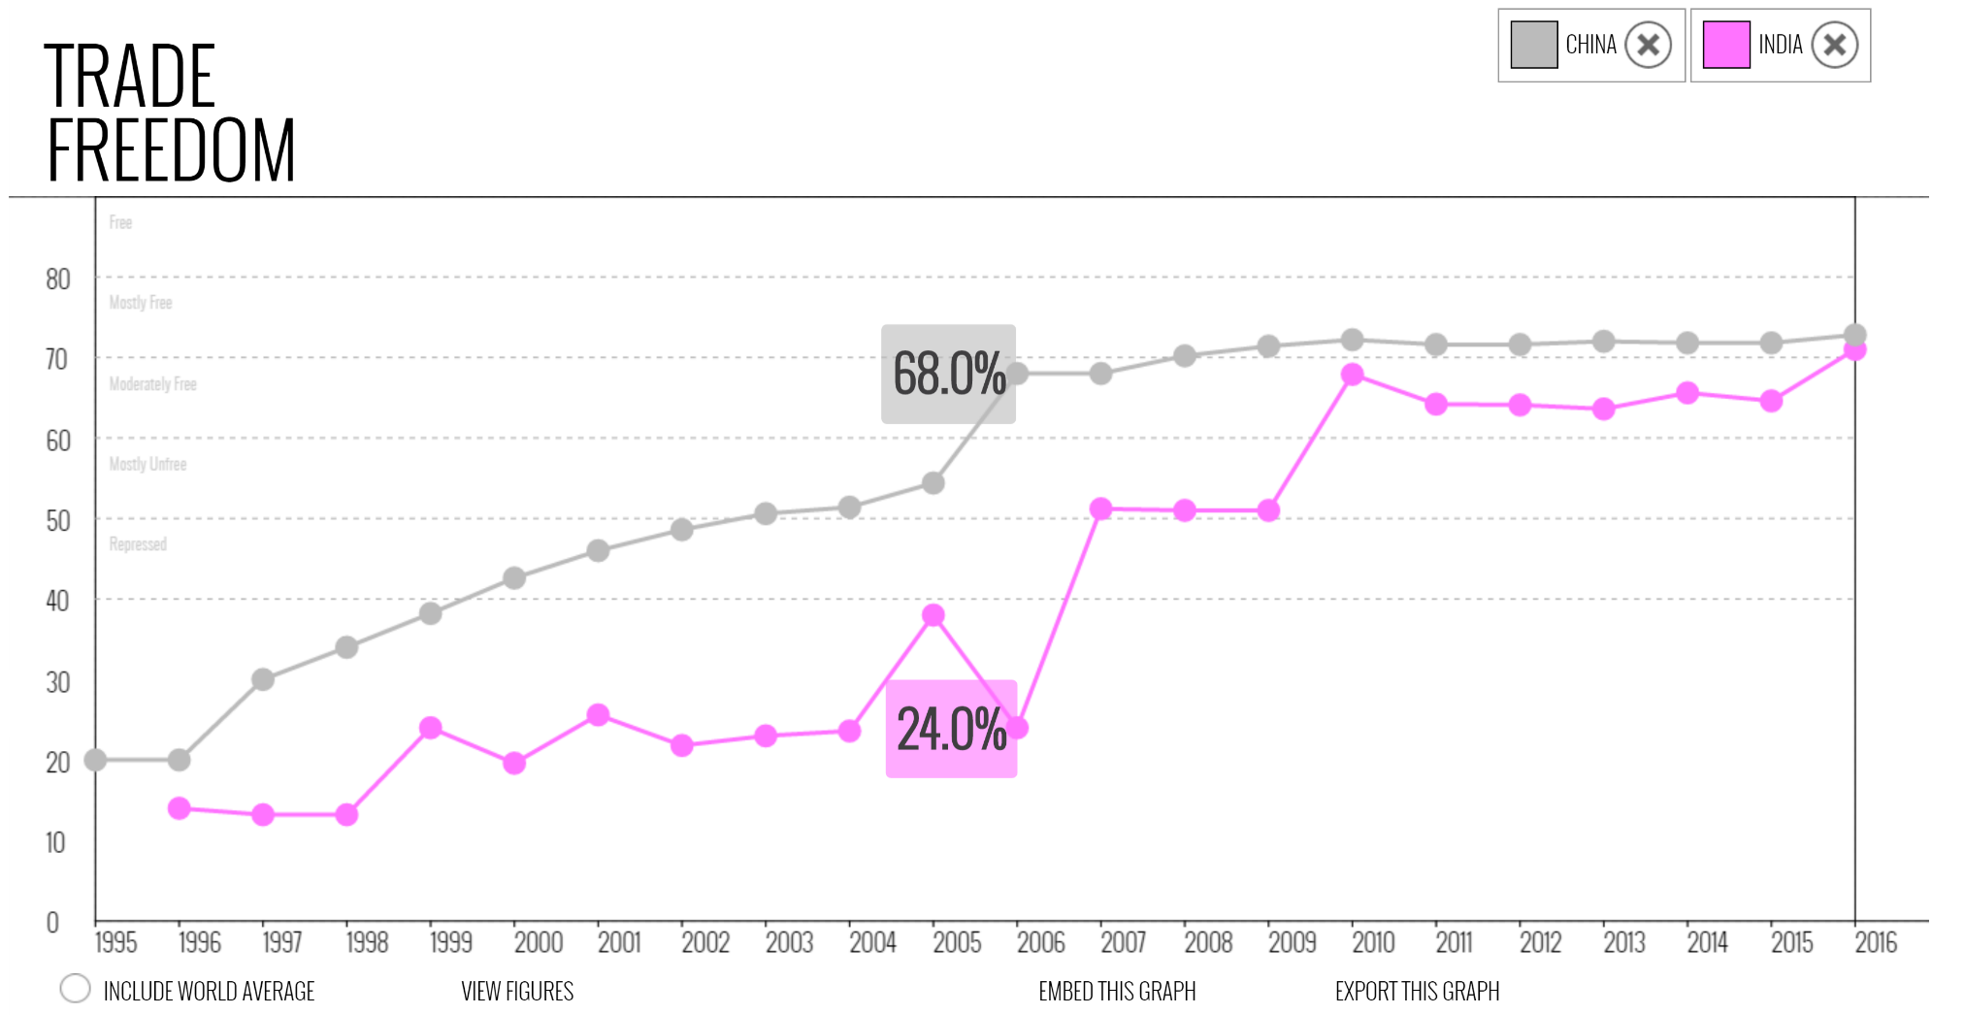
Trade freedom

Slide 33
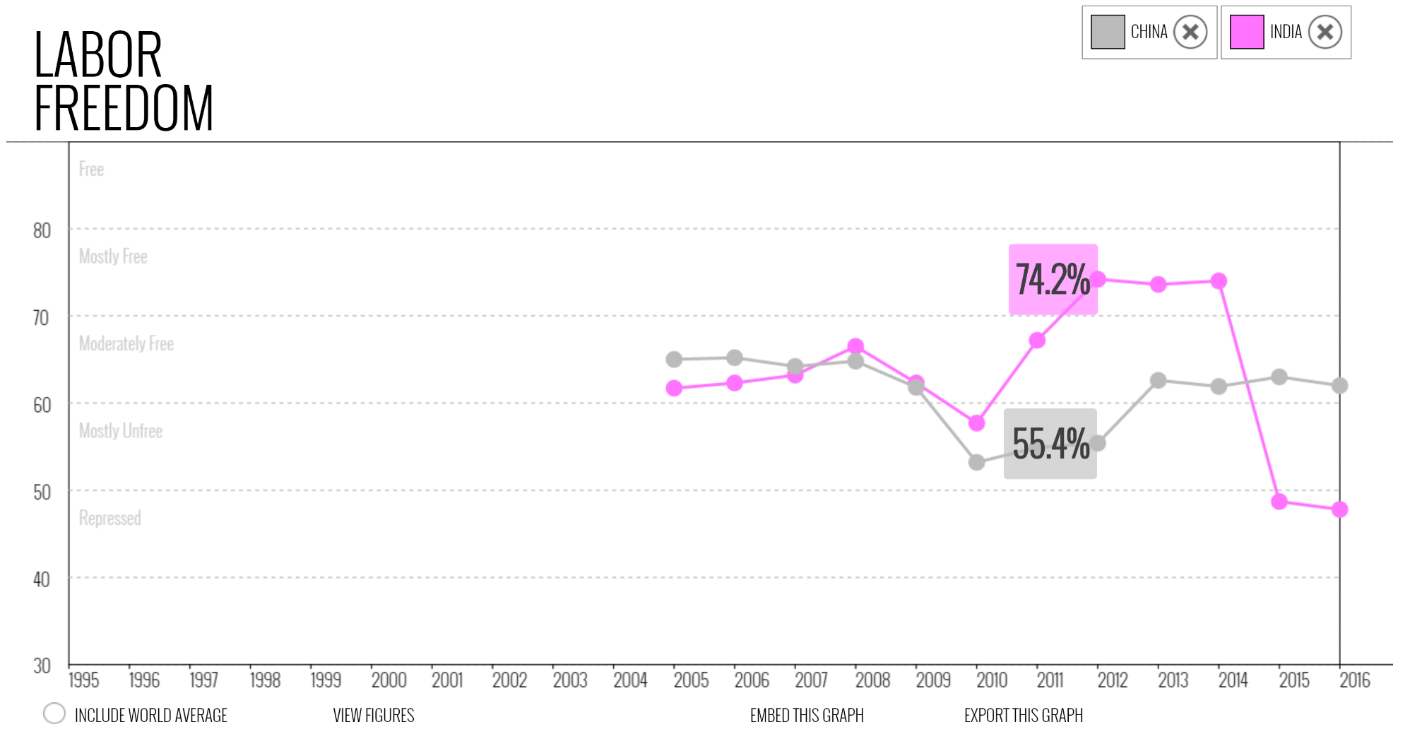
Labour freedom

Slide 34
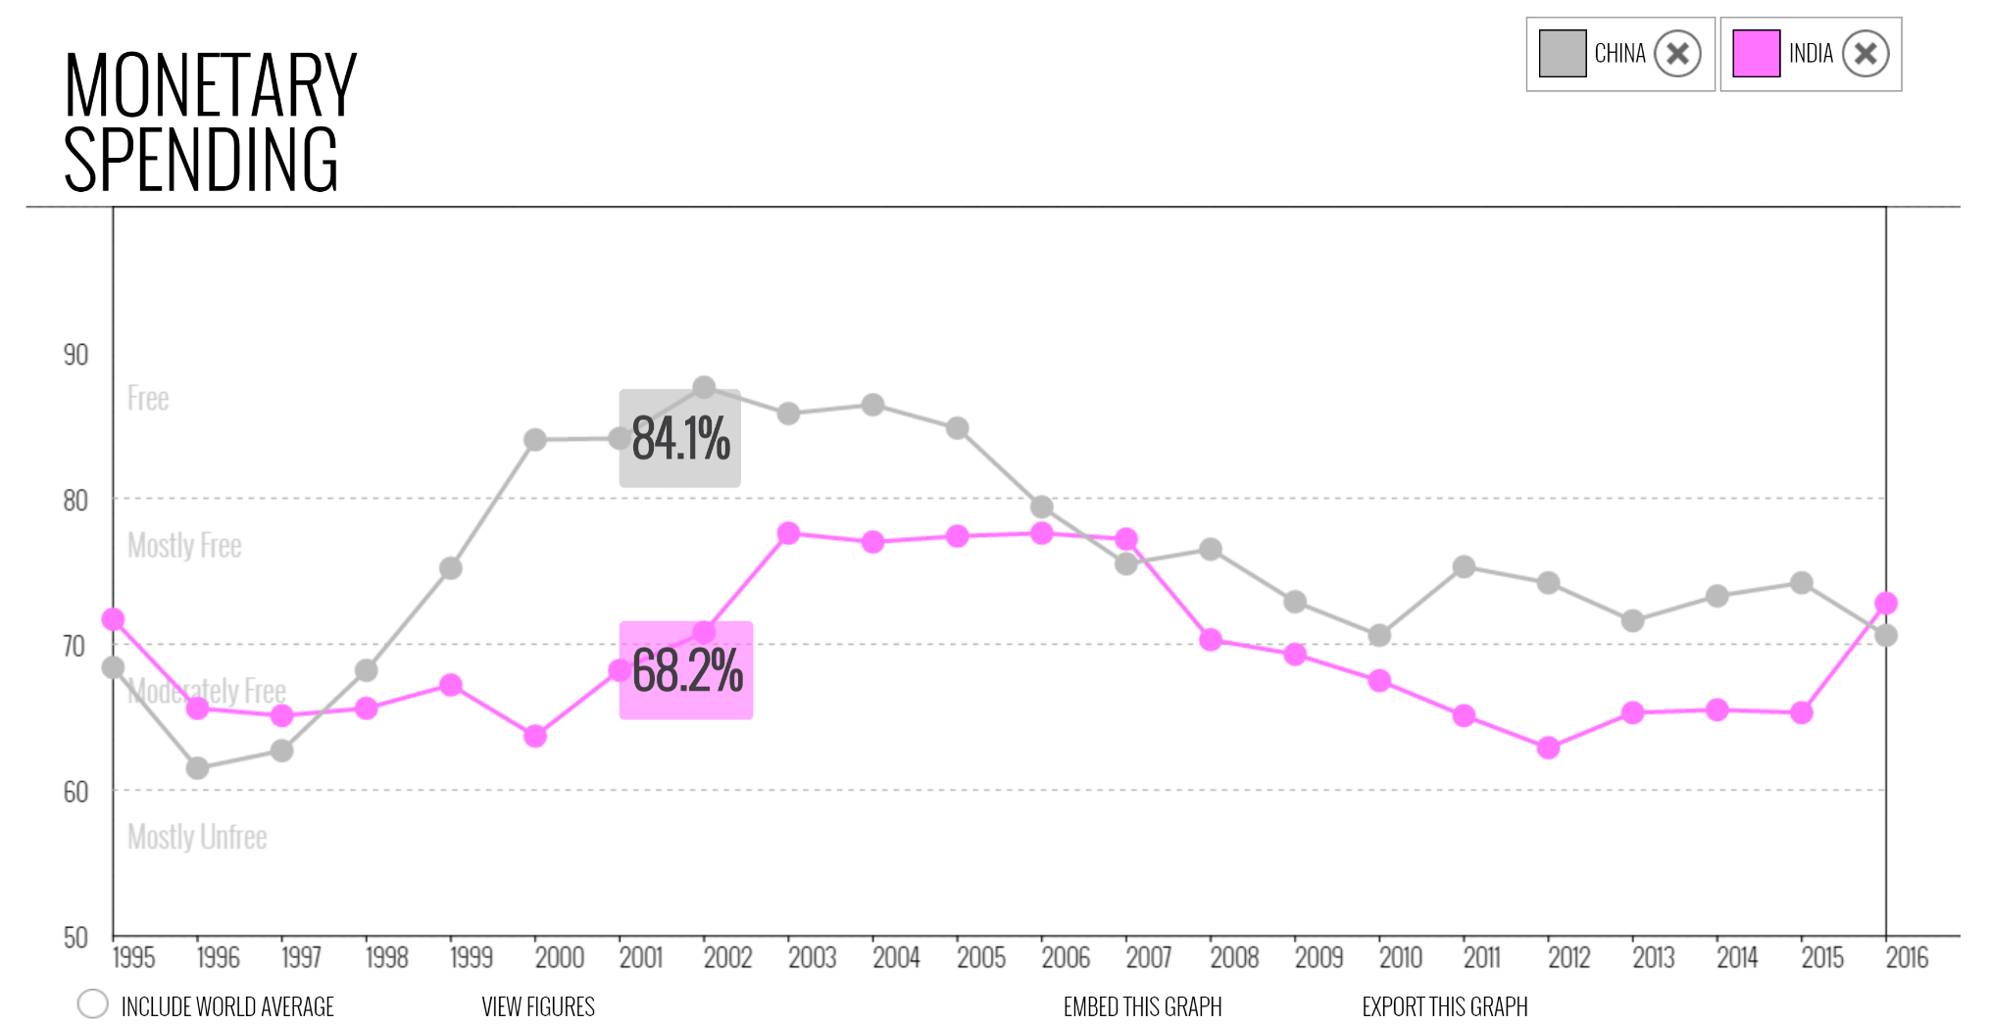
Monetary freedom

Slide 35
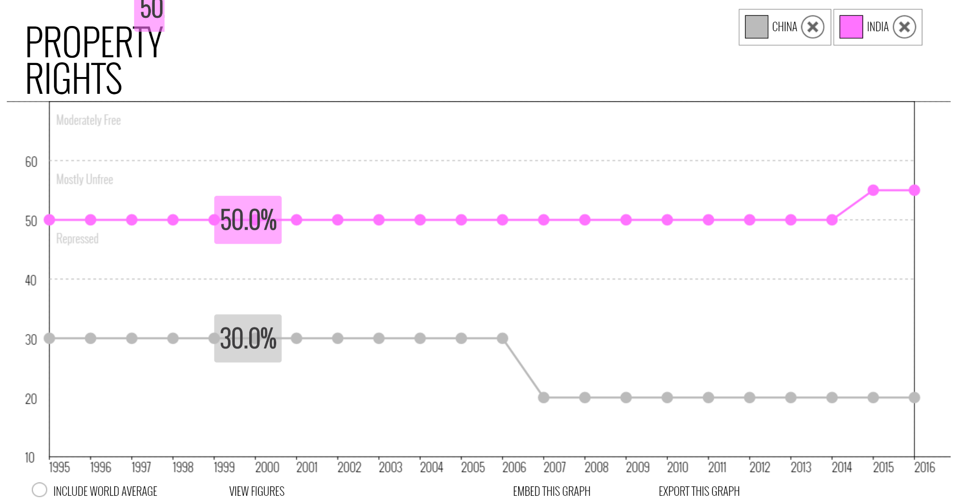
Property Rights

Slide 36
India Vs China (Wrapping Up)
When ever it comes to trading China surpasses India, the major reasons for this is there is no or little quality control in China.
As Chinese government follows communist economy, it’s spending on it’s people is more.
But when it comes to fiscal policies or human rights policies such as Labour laws, India is always more humane than China.
China is sitting on the top, while India still needs to progress a lot.
At global level sure India has made its impact, with increase in industrial and service sector this can be increased.

Slide 37
Problems faced in trade economy and Improvements at national level: India

Slide 38
Agricultural Sector (India)
As one of the most population driven sector with 51% of labour force, this sector contributes only 17% in the overall economy.
Improvements:
More focus on productivity by promoting Agro based industries and colleges, R&D. This also leads to less load of labour.
The extra force of labour can be shifted towards the Industrial and Service sector which contributes to (30+53)% of the economy.

Slide 39
Industrial Sector (India)
India is a very rich nation in minerals and rare-earth elements, the use of it in computers has grown almost as fast as cell phones. Before 1965, most of the world’s supply was produced from India and Brazil. Now, it has reduced to just 3%.
Improvements: Research and development in efficient extraction of these rare-earth elements should be enforced. Due to this, India gets more investments opportunities from tech driven companies instead in China.

Slide 40
Service Sector (India)
India being one of the dominant in the Service Sector with IT giants such as WIPRO, TCS, Infosys etc., still fail to provide the very Services(due to lack of Service opportunities) in India as 2/3rd of their clients are from outside the country.
Market size of IT Industry in India:
FY2015 Domestic: 48B$ Export: 98B$
Improvements: More Service opportunities can be generated by new start-ups and Gov. programmes, and thus local service trade is encouraged. Start-up India Stand-up India is the latest example of this.

Slide 41
Problems faced in trade economy and Improvements at national level: China

Slide 42
Agricultural Sector (China)
As the most populated country of the world, China certainly cannot afford to import Agricultural Commodities and increase the economic load per capita. It currently contributes to 12% of the total economy.
Improvements: 50% of overall labour work force is used up in the agricultural sector and it shares same ideas of improvements with India. It currently provides many facilities to people who are related with China agriculture.

Slide 43
Industrial Sector (China)
As China is more labour-oriented and contributes to 45% of it’s economy, machine-building and metallurgical industries have received the highest priority, these two areas alone account for about 20–30% of the total gross value of industrial output. Endless production of goods leads to deterioration in quality of local products
Improvements: Quantity and quality control is very much needed to earn the trust of consumers.
Being more industry oriented, it should also diversify this sector and not just oriented to some particular legacy industries.

Slide 44
Service Sector (China)
Despite ranking 3rd worldwide and contributing to 44.6% of the economy, the Chinese Service Sector is missing a lot of opportunities due to lack of language and communication support in English. Also, household demand for these high-end services isn’t satisfied, which is why we see Chinese people visiting other countries to study abroad and for medical tourism.
Improvements: Creating facilities for better education to their citizen such that they can directly contribute to Chinese service sector. Leaving the rigidity behind they should always thrive to achieve what is best for nation, hence including English as a language.

Slide 45
Indian trade
Until the liberalisation of 1991, India was largely and intentionally isolated from the world markets, to protect its economy and to achieve self-reliance.
Foreign trade was subject to import tariffs, export taxes and quantitative restrictions, while foreign direct investment (FDI) was restricted by upper-limit equity participation, restrictions on technology transfer, export obligations and government approvals; these approvals were needed for nearly 60% of new FDI in the industrial sector.
Since liberalisation, the value of India's international trade has increased sharply, with the contribution of total trade in goods and services to the GDP rising from 16% in 1990–91 to 47% in 2008–10.

Slide 46
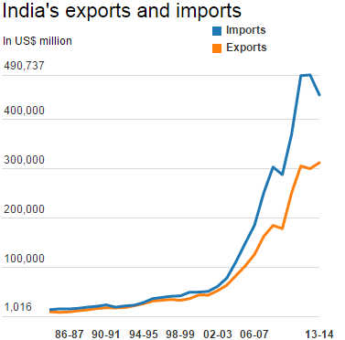
Indian trade (Import - Export)
Although India's imports have shot up at a faster pace than exports over the decades resulting in a widening gap in the trade balance. India's current account deficit widened to a record 4.8 percent of the GDP in the fiscal year 2013, before falling to 1.7 percent in fiscal year 2014 after the government clamped down on gold imports.

Slide 47
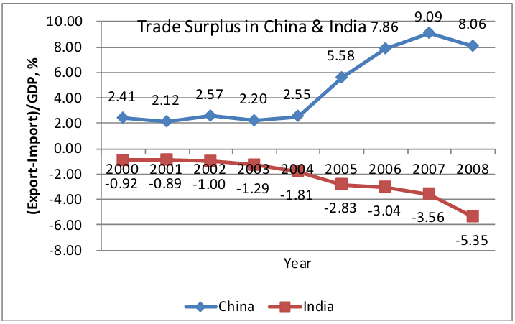
Indian trade (Not a mercantilist success)
India has not run trade surpluses, and even current account has mostly been in deficit.
Recent export growth part dominated by Chinese market, part of broader Asian production hub.
Services growing share of Indian economy, but “new services” other than finance and real estate still small (5 per cent of GDP and less than 1 per cent of total employment).
Basic development project far from complete.

Slide 48
Chinese trade
Trade has been a very significant factor of the People's Republic of China's economy. In the twenty-five years that followed the founding of the Republic in 1949, China's trade institutions developed into a partially modern but somewhat inefficient system.
The drive to modernize the economy that began in 1978 required a sharp acceleration in commodity flows and greatly improved efficiency in economic transactions.
In the ensuing years economic reforms were adopted by the government to develop a socialist market economy. This type of economy combined central planning with market mechanisms.
The changes resulted in the decentralization and expansion of domestic and foreign trade institutions, as well as a greatly enlarged role for free markets in the distribution of goods, and a prominent role for foreign trade and investment in economic development.

Slide 49
Chinese trade
In 2013 China surpassed the United States as the largest trading nation in the world and plays a vital role in international trade, and has increasingly engaged in trade organizations and treaties in recent years.
China became a member of the World Trade Organization in 2001.
China also has free trade agreements with several nations, including China–Australia Free Trade Agreement, China–South Korea Free Trade Agreement, ASEAN–China Free Trade Area, Switzerland and Pakistan.

Slide 50
Chinese trade (A mercantilist success)
2008: China recorded a trade surplus of $361 billion and a current account surplus of $390 billion.
India recorded a merchandise trade deficit of $92.4 billion. Even if the net surplus from services export is taken into account the deficit stands at $76.4 billion.
Net exports has been a trigger for growth for China, but not so for India.

Slide 51
India-China bilateral trade
It is the nature of China ­India bilateral trade as a confidence building measure that must be underlined to appreciate its interface with their political relations which remains so critical for its long ­term prospects.
Therefore, more than being measured in terms of statistics and profits, it is the political impact of trade which remains the barometer of their economic engagement.
Both sides clearly display that understanding at least in their more recent initiatives.
Moreover, with the inclusion of India’s trade with Hong Kong and Macao (as also India’s rising trade with Taiwan, and the possibility of an eventual unification of Taiwan), Greater China has already emerged as India’s largest trading partner and one of its kind.

Slide 52
India-China bilateral trade (Products)
Major items of export from India to China remain iron and chrome ore, plastic and linoleum, marine products, cotton yarn and fabrics, organic and inorganic chemicals, dye intermediates, bulk drugs and pharmaceuticals, construction quality wire rods, tobacco and tea.
While China’s exports to India include items like raw silk and silk yarn, coking coal, some types of chemicals, pulses, mercury and antimony, freshwater pearls, pig iron, newsprint and several low­ technology consumer items.
Gradually, many new sectors—like border trade or high­ tech trade—are being also explored while information technology and infrastructure development are already emerging as major areas for co­operation.

Slide 53
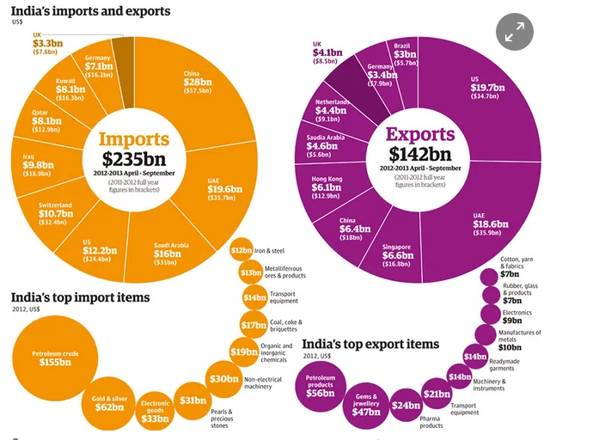

Slide 54
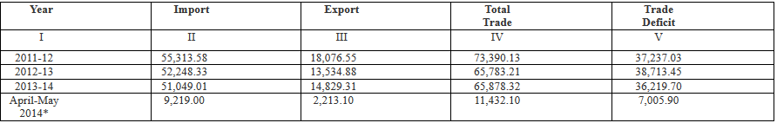
Bilateral trade (India’s Import-Export)
The following table shows the deficit in USD million dollars of India’s trade with China.
This deficit has decreased below 4000 in 2016 showing increase in economical strength of our country.

Slide 55
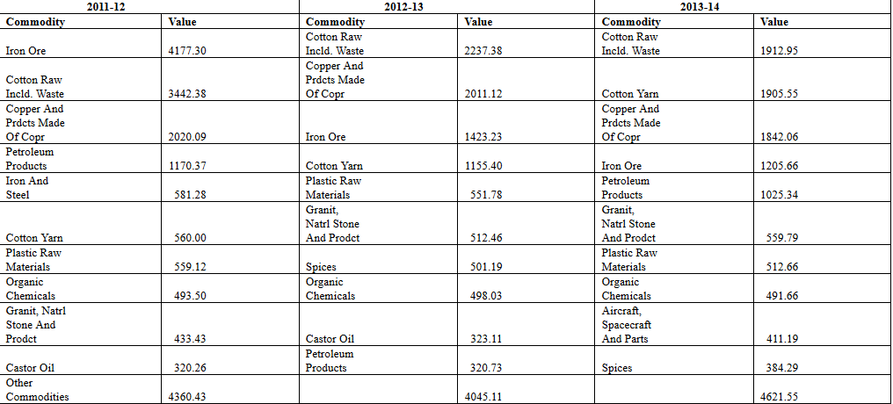
India’s Export to China
Values are in USD million dollar.

Slide 56
Bilateral trade (India’s Export)
Agricultural products and raw material for industrial sector are the main exports of India to China.
The main reason for this is India is a land of natural resources, many natural resources are abundantly available in India.
Along with that many crude products are also exported to China.
This demand is increasing day to day, due to increase in population and China’s greed to produce more industrial product.
India’s export to China crossed 5 billion mark in 2015 and is still growing.

Slide 57
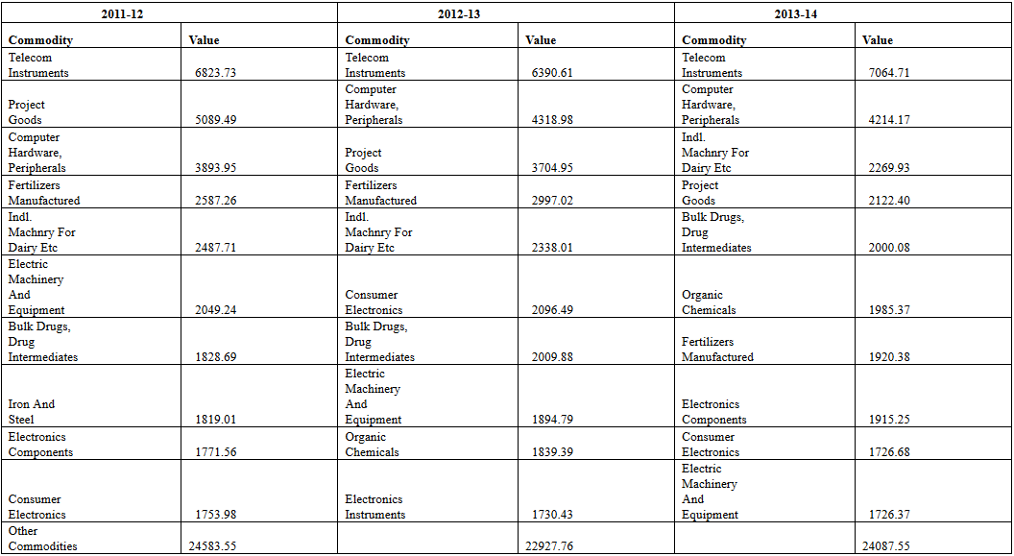
China’s export to India
Values are in USD million dollars.

Slide 58
Bilateral Trade (China’s export to India)
China mainly exports electronic goods, to India.
The main reason being, as stated earlier China has no regulatory issues hence many low quality goods are produced, these goods are dumped into our nation and then sold at a very low rate.
China takes raw material from India and exports finished goods, as there labour is cheap.
These import bills of India has decreased and reached below 20,000 million in fiscal year 2016 showing strength of Indian economy.

Slide 59
Certain pressing issues in bilateral trading
Various Trading Problems:
Limited market access to Indian products in china is one of the major reasons for widening deficit.
The online access of Indian products will merely solve the problem. Decline in export of agriculture products like coffee , tea, spices, sugar.
Decrease the custom duty of these products and give incentives and subsidies to those who are exporting these product.
Too much depended upon china in electronic products.
Emphasis more on development and growth of Indian electronic products manufacturer by way of subsidy and tax benefits.

Slide 60
Certain pressing issues in bilateral trading
Government Restriction:
For import and exports of goods, various licenses are taken and various information are to be submitted.
Government should simplify the procedure to obtain various licences required for international trade.
Difficulty in payment:
Try to simplify procedures of obtaining Letter of Credit from bank for ease of international payment.
Lack of information:
Maintain online database and online help portal for delivering information to traders.
Economic Dependence(depending fully upon another countries for raw materials and other goods):
For reducing economic dependence, try to collaborate with different countries which can provide the same raw material.

Slide 61
Group 5
Thank You !!!

